Slide 1
Prepositions

Slide 2
Contents
Purpose
Rules
Common problems
How to improve your use
Choosing the correct preposition
Sources and SELF resources

Slide 3
Purpose of prepositions
To show the relationship between the nouns, verbs, and adjectives in a sentence:
A person and their location or destination
An object and who it belongs to
An event and when it happens

Slide 4
Rules: 1
Prepositions can be followed by nouns or gerunds
√ I ’m looking forward to having lunch.
√ I ’m looking forward to lunch.
Pronouns should be in object, not subject form
Reflexive pronouns should be used if the preposition’s object is the same as the sentence’s subject
X The students submitted the essays to Dr Sadorra and I.
√ The students submitted the essays to Dr Sadorra and me.

Slide 5
Rules: 2
Prepositions are usually used immediately before their objects
√ The argumentative essay will be assigned after the recess.
Prepositions + objects come at the beginning of sentences for emphasis
√ After the recess, the essay will be assigned.

Slide 6
Rules: 3
In some cases, the object of the preposition is separated from the preposition:
Direct questions
What do you attribute your success to?
Indirect questions
The students wondered who/whom the tutor was referring to.
Relative clauses
The prototype that the tutor referred to received more funding.
Passive constructions
The new prototype was repeatedly referred to.

Slide 7
Rules: 4
The sentences can be more formal if the preposition is immediately before its object
Direct questions
√ To what do you attribute your success?
Indirect questions
√ The students wondered to who/whom the tutor could be referring.
Relative clauses (not used with ‘that’)
√ The prototype to which the tutor referred received more funding.

Slide 8
Common preposition problems
A preposition can have different meanings
Behind can mean:
at the back of (Is there a car behind us?)
responsible for (She’s behind the company’ new image.)
not as successful as (Rio’s infrastructure is behind London’s.)
Different prepositions can have a similar meaning
Above: higher than (The salaries we offer are above average.)
On top of: the higher object is touching the lower one (Put your books on the table.)

Slide 9
Prepositions and phrasal verbs

Slide 10
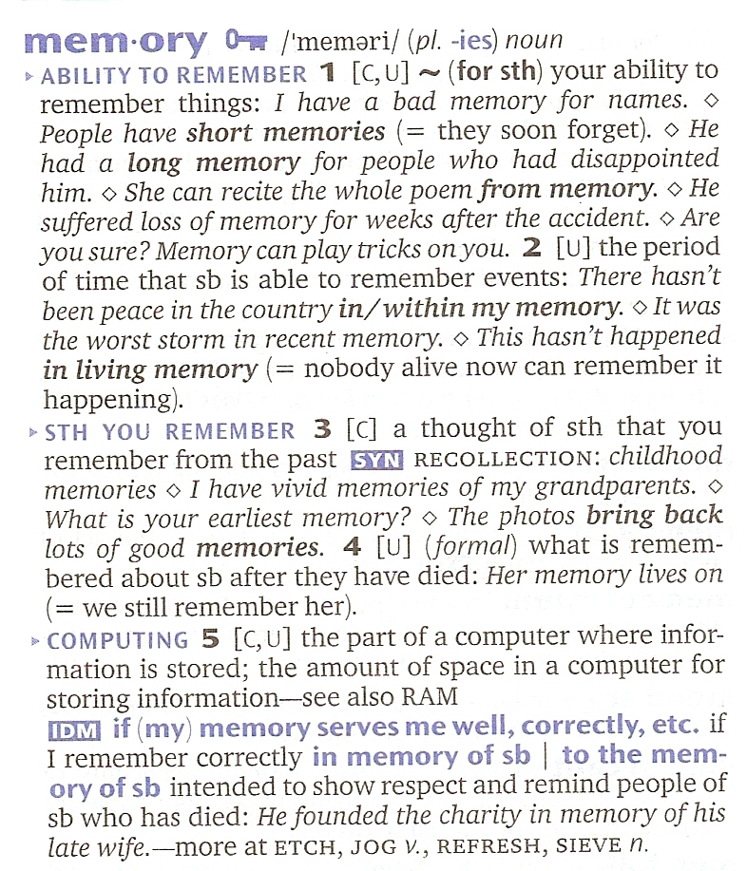
How to improve
Notice which prepositions occur with verbs, nouns and adjectives when reading
Use an advanced dictionary to learn new items of vocabulary with their prepositions
Use online concordancers such as lextutor.ca

Slide 11
Choose correct prepositions 1
Prepositions show the following relationships:
Position in space
Movement through space
Time
Condition, state or what something is like
Means or how something happens
Inclusion/exclusion
Intention and purpose
Cause and reason
Possession

Slide 12
Choose correct prepositions 2
The more abstract relationships are extensions of the most concrete
The meaning of ‘in’ when used to describe position in space is extended when talking about more abstract relationships, such as time and condition

Slide 13
Examples of extension
My brother’s presents are in my suitcase.
The suitcase is a limited physical space containing the presents.
I visited him in May.
May is a limited period of time when I visited.
My brother is in love.
Love is a limited state involving my brother.
Love is limited due to the concept of “out of love”.

Slide 14
Choices
The children love to be by the sea.
The sea is a point that is separate from another location.
The children love to be on the sea.
The sea is a surface that supports something like a boat.
The children love to be in the sea.
The sea is a container that encloses children doing an activity.

Slide 15
Position
Choose a preposition based on how you think of the space
Point: at, next to, near, far from, before, after, above, below, between, apart from
Line or surface: on, by, beside, across, in front of, behind, on top of, off, against
Container: in, inside, within, through, among, out of, outside

Slide 16
Movement
Choose a preposition based on how you think of the space
Point: to, from, toward(s), away from
Line or surface: onto, along, out from, across
Container: into, out of, about, through

Slide 17
Time
Point:
at 6:30/ the end of the month/ that time/ Christmas
on Monday/ 29 March/ my birthday/ Christmas Day
Period:
Points of time at the beginning or end of a period: since Monday/ by the end of the month/ before 5pm/ after the holiday/ until next week
Inside a period of time: in 1962, during the day, throughout June
Inside a now complete period of time: for 3 years
Beginning & ending limits to a period of time: from…to, from…until

Slide 18
Conditions and states
Defined state: at fault/ at work
Point reached after some time: to sleep, into a panic
State of short duration: on sale, off duty
State of being influenced: under pressure
Continuing for an undefined period : in love, in business, in doubt
Leaving a state: out of work

Slide 19
Means
How something happens or is done:
pay by cash
achieved through his connections
Who or what does something:
profit made by companies
What is used to do (or not do) something: cover with plastic
not finish without more time

Slide 20
Inclusion and exclusion
Inclusion of defined people, groups, things or qualities: with us, with your meal
Exclusion of defined people, groups, things or qualities: without my glasses
Inclusion in a pair / group: among the biggest problems, between us

Slide 21
Intention and purpose
Something you want to have:
ask for more time
Someone you intend to give something to: wrote a song for you
Something you intend to do or give:
invite for dinner
Destination or goal:
aim for excellence
Opposition:
against the plan

Slide 22
Cause and reason
Reasons:
famous for something
Cause of something negative:
suffering from a bad back
Cause feeling or thought:
acted out of jealousy
Cause an emotional response:
amazed at the size

Slide 23
Possession
Who or what something belongs to or is part of:
University of York, slice of lemon
Person’s behaviour:
kind of you
Possession of features or qualities:
woman with red hair, player of great talent

Slide 24
References
For more practice, refer to the following books in SELF:
Lane, A. and Lange, E. (1999). Writing Clearly: An Editing Guide (2nd ed.). Boston: Heinle and Heinle Publishers.
Sargeant, H. (2002). Understanding Prepositions. Singapore: Learners Publishing.
Yule, G. (2006). Oxford Practice Grammar: Advanced. Oxford: University Press.

